Slide 1
Economic Models
Steven Suranovic
George Washington University

Slide 2
Economic Models
Uses deductive reasoning to create simplified real-world economic relationships
Models are simplifications!
Presents these in mathematical and/or graphical form
Can be used to identify the conditions needed for certain outcomes to arise

Slide 3
Deductive Reasoning
If X (a set of assumptions) is True … then
Y ( a set of conclusions or implications) follow logically
If all dogs have four legs, and if Duke is a dog, then Duke has four legs.

Slide 4
A Logical Fallacy
What if an assumption is not true … does it follow that the conclusions are untrue? Answer – No
For example, If all dogs do not have four legs, and Duke is a dog, it does not follow that Duke does not have four legs.
He still might … we just can’t know for sure

Slide 5
A Logical Fallacy
In economic models then
Just because some assumptions do not match the real world, does not mean we can dismiss all the conclusions
But models will tell us what MUST be true to guarantee certain outcomes or results

Slide 6
Assumptions vs. Implications
All of the IFs in an economic model are the ASSUMPTIONS
Generally there are numerous assumptions
All of the THENs in a model are the IMPLICATIONS
Generally there are many fewer implications

Slide 7
Types of Assumptions Reflect Reality vs. Simplifying
Assumptions that reflect reality are included because they are an observed feature of the real world.
Assumptions that are simplifying are included to make the model tractable (that is, to make it easier to comprehend and solve)

Slide 8
Types of Assumptions Consequential vs. Inconsequential
If you relax (that is, change or eliminate) a consequential assumption, then an implication is no longer guaranteed.
Often, assumptions that reflect reality are consequential
If you relax (that is, change or eliminate) an inconsequential assumption, then the implications are not affected.
Many assumptions that are simplifying are inconsequential

Slide 9
A Map as a Model
Maps can be transformed into a deductive exercise
Namely, If (x,y,z, etc) are true, then (A, B, C, etc) follow

Slide 10
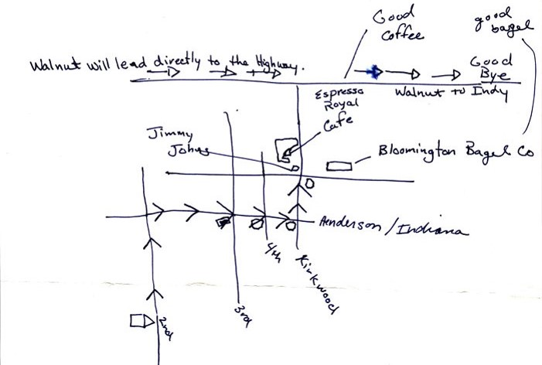

Slide 11
Hand-drawn Map Model
Assumptions
Implications
Lines are streets
Street names are accurate
Arrows are direction of travel
Breakfast locations accurate
O at intersections are stop signs
Etc, etc.
Travel along arrowed roads will lead you out of town
If you want breakfast, you can stop at recommended shops along the way

Slide 12
Assumption Types
Reflect Reality
Simplifying
Street names are accurate
Arrows are direction of travel
Breakfast locations accurate
Lines are streets
O at intersections are stop signs
Many streets and names missing
Scale is inaccurate
Bldgs are simple shapes

Slide 13
Assumption Types
Consequential
Inconsequential
Starting location is accurate
Stop sign locations
Street names are accurate
Arrows are direction of travel
Breakfast locations accurate
Lines are streets
O at intersections are stop signs
Scale is not accurate

Slide 14
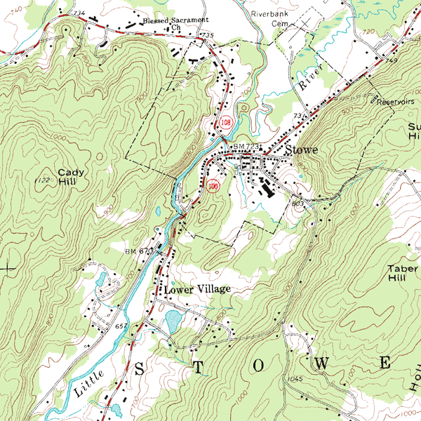

Slide 15
Topo Map Model
Assumptions
Implications
Green areas are forested
Brown lines are contours (iso-elevation)
Streets are double black lines
Structures are small black circles
Etc.
Can use to determine slope/grade when hiking
Can used to plan troop movements for war

Slide 16
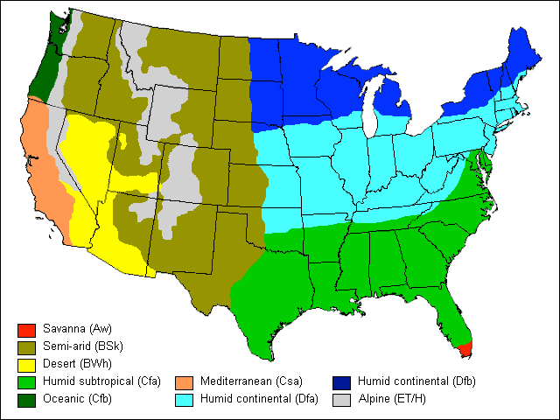

Slide 17
Maps as Models
Create different maps (models) for different purposes
Some assumptions may be the same, some will differ
There is no ideal map (model)
Same is true for economic models

